Slide 1
OPS245 Week 11
Jonathan.ye@senecacollege.ca
Notes:
Setup and Configure Secure Shell Services
Network Services
SSH
Lecture Notes:
Securing Network via SSH
Configuring Firewalls (iptables)
Lab 7: Setup and Configure SSH

Slide 2
Introduction - sshd
In this lesson you will learn the basic concepts of configuring a service on Linux.
We will use the SSHD service because it is one you are already familiar with from the client side.
Most of the concepts that we see here will be applied to numerous services you work with throughout your career.
Notes:
Configuring a Service SSHD
Similar to any other network services, it has daemon associated. Dnsd, dhcpd, etc, etc
See below can help to explain.
A daemon is a long-running background process that answers requests for services. The term originated with Unix, but most operating systems use daemons in some form or another. In Unix, the names of daemons conventionally end in "d". Some examples include inetd , httpd , nfsd , sshd , named , and lpd

Slide 3
Network Administration
As system administrators, one of our primary jobs is setting up a network, as discussed in our previous lecture and covered in Lab 6.
However, once it’s set up, we must maintain that network, and any computers or services that are a part of it.
Network maintenance includes troubleshooting, fixing connection issues, and maintaining network security.
Notes:
All network devices and services set up such as VPN, file server, DNS, DHCP, router and switch, firewall, remote connection.
Backup and restore
Any performance monitoring and maintenance.
Etc, etc.
Find at least 3 job posts of network administrator and you can find what are expected.

Slide 4
Hardening a Network
System administrators need to protect, or ”harden”, their networks from penetration by unauthorized computer users.
Whether it be from hackers, corporate espionage, or scams, we have to be smart about what we expose to the Internet.
Hardening a computer system can range from:
Running an IDS (Intrusion Detection System)
Monitoring and flagging suspicious activity
Implementing security policies like running firewalls or setting locked screensavers on workstations
Notes:
IDS or central monitor system are not in our scope. They are not Linux OS either.
Again, please find information for yourself. You do not want that you are UNABLE to answer when someone asks you.

Slide 5
What is SSH? – published in 1995
In Lab 7, we focus on SSH in order to help secure your Linux network.
Secure Shell (SSH) is a cryptographic network protocol for running unsecure services over a secure tunnel. Basically, it allows you to run things remotely. Using SSH, you can use another computer to run a program from one of your Linux machines.
The most common use of SSH is for remote login. This gives you access to the CLI on a computer or VM without needing to be physically (or virtually) present.
In ULI101, you used SSH to login to Matrix.
Notes:
Read the history of ssh, you will know why SSH can help you from password sniffing attack.
https://www.ssh.com/about/history/?hsLang=en
After a password-sniffing attack at his university network, Tatu Ylönen designed the first version of the Secure Shell (SSH) protocol. 25 years later, more than 95% of the servers used to power the internet have SSH installed. The internet as we know is largely managed using SSH.
But how did this all happen? How did the protocol become a cornerstone of a safe internet, and what does a European Commissioner or a lego brick have to do with it?

Slide 6
Accessing a Service
When accessing resources over a network, you typically need two things:
Client
Host (i.e. Server)
In ULI101, you were the client, connecting to Matrix, the host/server.
For Lab 7, we’re going to set up an SSH server ourselves.
Notes:
Actually, we say 3 things: client, server and protocol.
Please understand that SSH can be used to secure file transfer, email, sign, forms and terminal connection.
Most Linux systems come with the open source OpenSSH preinstalled.
Windows SSH client alternatives
PuTTY (Free, Windows)
WinSCP
FileZilla
Mac SSH client alternatives
CyberDuck (Free, Mac)
Commander One (Free, with Commercial Pro version)

Slide 7
SSHD
On CentOS, we use OpenSSH-Server. Once installed, you can interact with it via its systemd name, sshd.
The SSH service is usually installed by default. To check, we can run our rpm command:
rpm -qa | grep ssh
or
yum info openssh-server
Notes:
How can you tell if sshd is up running?

Slide 8
Working with SSHD
The SSH server has a configuration file we’ll be working with:
/etc/ssh/sshd_config
You can use vi to modify this file and change the configuration. Any modifications you make won’t take effect until you restart the SSH server:
systemctl restart sshd - restart SSH
systemctl status sshd - status of SSH Server
If you restart the server after making changes and it fails, double-check your sshd_config file for typos. This is the most common problem, and should be the first thing you look for.
Notes:
Sshd can work in different Oss.
i.e. Windows OS:
https://docs.microsoft.com/en-us/windows-server/administration/openssh/openssh_install_firstuse
Suggest read it.

Slide 9
Hardening SSHD
When we start up the SSH server, we’re opening access to the computer’s CLI via the network (including the Internet).
While sshd comes with certain default security measures, your typical hacker will know these defaults and use that to try and break in.
There are a couple of settings we’ll change to help harden our service:
PermitRootLogin=no
AllowUsers username1 username2 …
Notes:
Read the 10 tips here:
https://linuxhandbook.com/ssh-hardening-tips/
1. Disable empty passwords
2. Change default SSH ports
3. Disable root login via SSH
4. Disable ssh protocol 1
5. Configure idle timeout interval
6. SSH access to selected users only
7. Disable X11 Forwarding
8. Mitigate brute force attacks automatically
9. Disable password based SSH login – say use only key based
10. Two-factor authentication with SSH

Slide 10
Public/Private Keys
When you connect to a computer with an SSH server, you’re presented with a login screen. You are prompted for your username and password, and then allowed access if your credentials are correct.
However, if your username and password are stolen (or guessed), someone else impersonating you can login. How do we prevent this?
We use public and private keys to make users prove who they say they are.
Notes:
The key file unique format and special generation mechanism can help to avoid “copy or fake” access.

Slide 11
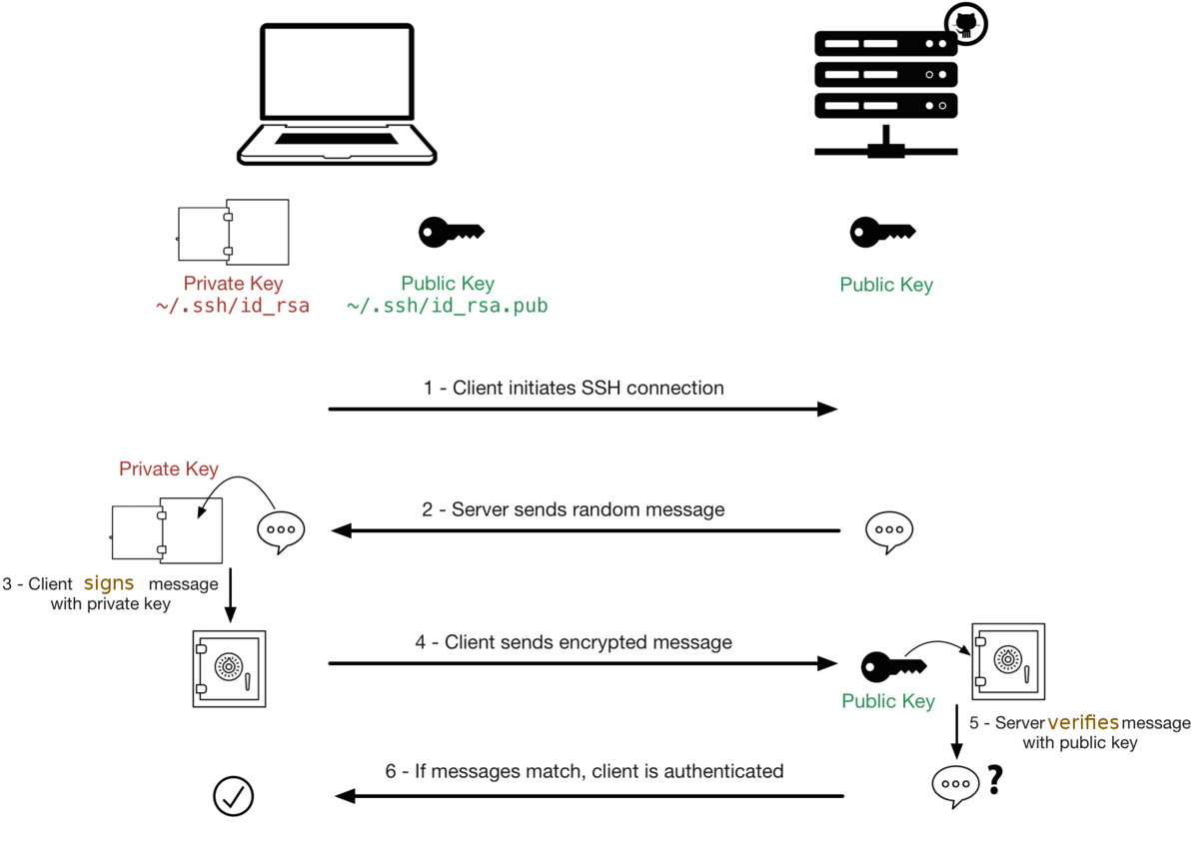
Public/Private Keys Cont.
Notes:
You need to understand the process to achieve the no password (passwordless) log in. ☺
The private key is retained by the client and should be kept absolutely secret. As an additional precaution, the key can be encrypted on disk with a passphrase.
The associated public key can be shared freely without any negative consequences. The public key can be used to encrypt messages that only the private key can decrypt. This property is employed as a way of authenticating using the key pair.
Ssh-keygen
Default is ~/.ssh and private key is id_rsa and public key is id_rsa.pub
You will then be prompted for a pass-phrase. The pass-phrase must be entered in order to use your private key. Pass-phrases are more secure than passwords and should be lengthy, hard to guess and easy to remember.
Please understand that you generate the key and copy public key to destination
ssh-copy-id -i ~/.ssh/id_rsa.pub ops245@centos3

Slide 12
Creating Key Pairs
To use this method, we need to do two things on our client machine:
Generate a public/private key pair:
ssh-keygen
Copy the public key to the SSH server:
ssh-copy-id username@servername
If you stored your keys in a non-default location, you can use -i to provide the path to the public key.
You’ll need your server username and password to copy the public key over to the server.
It’s important to remember which file is the public key! Your private key should never be transferred anywhere, unless you really know what you’re doing.
Notes:
Same challenge to you: find if we use the same command in other Linux distros. :0

Slide 13
Why Use Key Pairs
This allows for faster, convenient login for users, but how does it help us as administrators?
The method from the previous slide requires the user know the password for their remote account to install their key. If you’re worried about security, there’s a second method.
As a sysadmin, you have the user generate their keys with ssh-keygen, and ask them to send you their public key. You can then install that key onto the remote user without ever needing to give them a password.
Not only does this ensure only the right person is logging in to their account, but it also allows you to solve unauthorized access.
Notes:
What if you need to initiate connection from 2 computers Can you use the same pub key? Can you use the same private key?

Slide 14
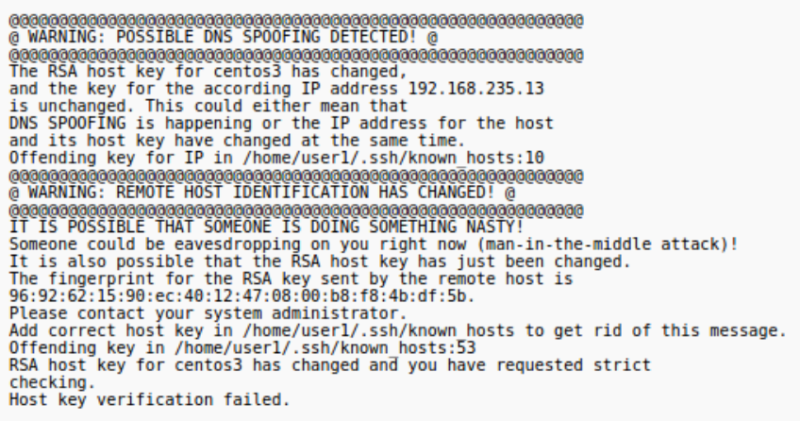
ARP Poisoning
A common type of attack, ARP Poisoning (aka DNS spoofing, a form of man-in-the-middle attack), can be used to redirect packets to a third destination while maintaining the illusion that the connection is secure.
If you ever see a warning message like this one when you try to connect via SSH, it could be a sign of a serious security breach.
This can also happen if the server OS has been reinstalled, so investigate further.
Tip: If you have reinstalled a VM/OS, you can get rid of this message by deleting the host key entry inside ~/.ssh/known_hosts
Notes:
Address Resolution Protocol (ARP) poisoning is when an attacker sends falsified ARP messages over a local area network (LAN) to link an attacker’s MAC address with the IP address of a legitimate computer or server on the network. Once the attacker’s MAC address is linked to an authentic IP address ...
An ARP spoofing, also known as ARP poisoning, is a Man in the Middle (MitM) attack that allows attackers to intercept communication between network devices.
The ARP spoofing attacker pretends to be both sides of a network communication channel
Once the attacker succeeds in an ARP spoofing attack, they can:
Continue routing the communications as-is⁠—the attacker can sniff the packets and steal data, except if it is transferred over an encrypted channel like HTTPS.
Perform session hijacking⁠—if the attacker obtains a session ID, they can gain access to accounts the user is currently logged into.
Alter communication⁠—for example pushing a malicious file or website to the workstation.
Distributed Denial of Service (DDoS)
If the table (arp –a result) contains two different IP addresses that have the same MAC address, this indicates an ARP attack is taking place.
To discover ARP spoofing in a large network and get more information about the type of communication the attacker is carrying out, you can use the open source Wireshark protocol.
Here are a few best practices that can help you prevent ARP Spoofing on your network:
Use a Virtual Private Network (VPN)⁠—a VPN allows devices to connect to the Internet through an encrypted tunnel. This makes all communication encrypted, and worthless for an ARP spoofing attacker.
Use static ARP⁠—the ARP protocol lets you define a static ARP entry for an IP address, and prevent devices from listening on ARP responses for that address. For example, if a workstation always connects to the same router, you can define a static ARP entry for that router, preventing an attack.
Use packet filtering⁠—packet filtering solutions can identify poisoned ARP packets by seeing that they contain conflicting source information, and stop them before they reach devices on your network.
Run a spoofing attack⁠--check if your existing defenses are working by mounting a spoofing attack, in coordination with IT and security teams. If the attack succeeds, identify weak points in your defensive measures and remediate them.

Slide 15
SSH Tunneling
In addition to CLI access, we can run graphical Linux (X window) applications over the network (between machines).
Some GUI applications are known to be insecure when run this way. Instead of running them directly, we can call them via SSH, through what’s called an SSH tunnel.
Using SSH, we can establish a secure, encrypted tunnel, and send the graphical information through that. For all practical purposes, this makes the information unreadable by third parties.
We’re going to use gEdit for our example GUI application.
Notes:
More details can be found https://www.ssh.com/academy/ssh/tunneling

Slide 16
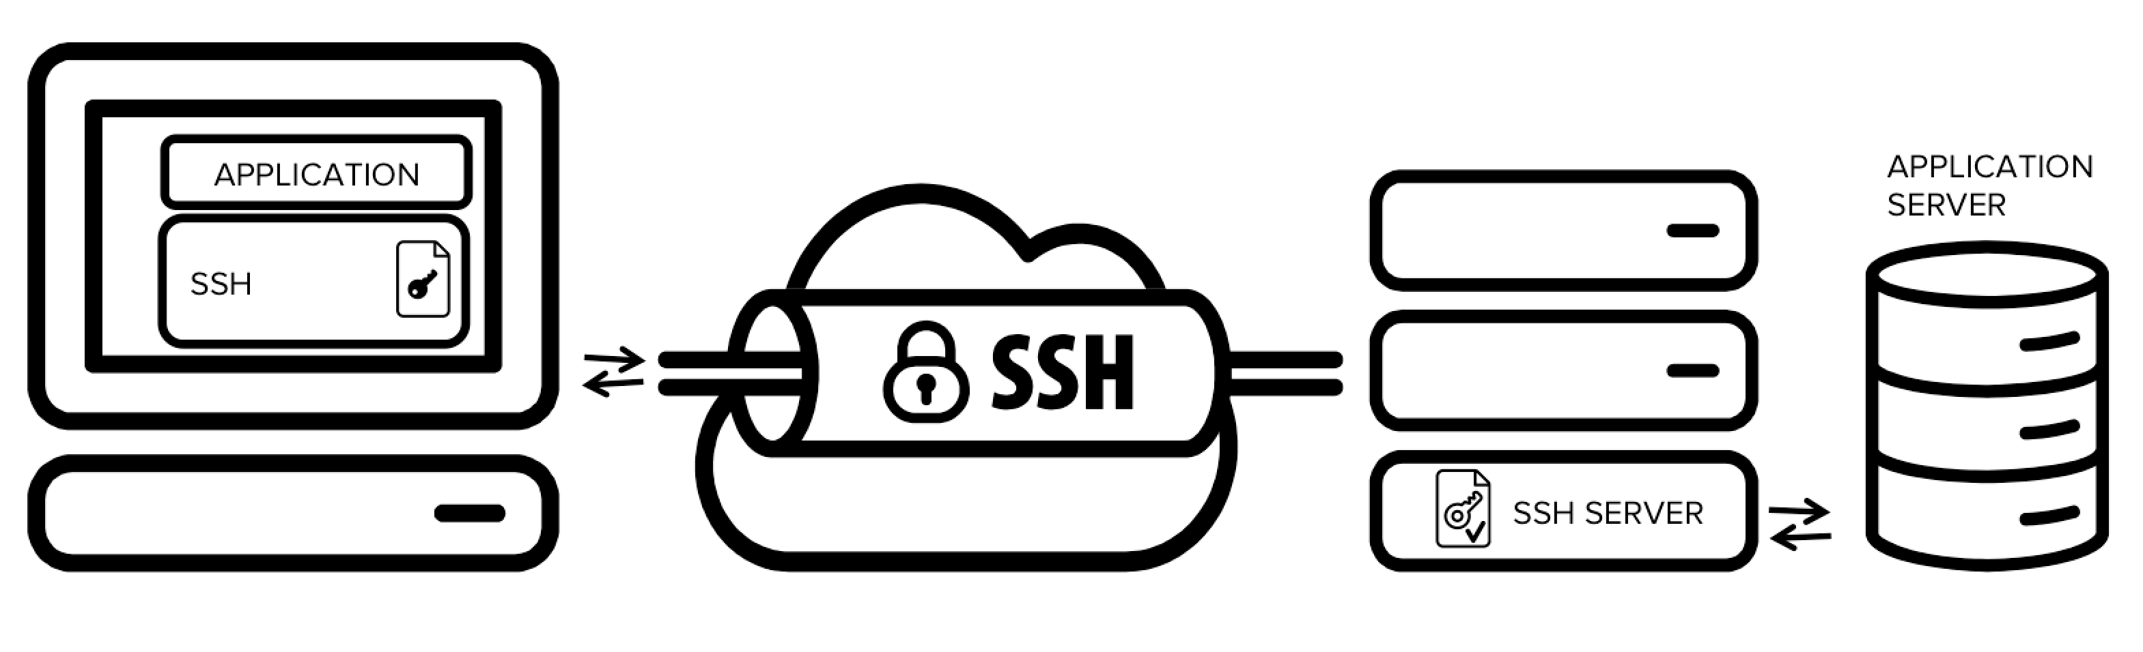
Challenge or potential security issues
Notes:
The downside is that any user who is able to log into a server can enable port forwarding. This is widely exploited by internal IT people to log into their home machines or servers in a cloud, forwarding a port from the server back into the enterprise intranet to their work machine or suitable server.
Hackers and malware can similarly use it to leave a backdoor into the internal network. It can also be used for hiding attackers's tracks by bouncing an attack through multiple devices that permit uncontrolled tunneling.
Benefit:
SSH tunnels are widely used in many corporate environments that employ mainframe systems as their application backends. In those environments the applications themselves may have very limited native support for security. By utilizing tunneling, compliance with SOX, HIPAA, PCI-DSS and other standards can be achieved without having to modify applications.

Slide 17
Creating an SSH Tunnel
To do this, we must first create the tunnel:
ssh -X -C yourUsername@servername (or IP)
-X: enables the forwarding of X window information
-C: enables compression for better performance
Once you’re logged in, call the graphical application from the command line, and it’ll pop up on your computer from the server.
You can also do this all as one command:
ssh -X -C yourUsername@servername gedit
Obviously, the above only works if it’s in the server’s PATH search variable (aka you can call the program from anywhere on the system). Otherwise, use absolute pathing to call the app. (e.g. /usr/bin/gedit)

Slide 18
Summary
In this lesson you have learned how to configure the SSHD service.
While this will directly help protect your networks, the techniques you started to learn here will also apply to many other services you work with.

Slide 19
OPS245
Configuring Firewalls
iptables
Notes:
Before we go any further, I like to remind you that do not forget going through those items in lab 7:
Networking Utilities ssh ssh-keygen ssh-copy-id scp sftp ss ip ping arp iptables
Additional Utilities hostname restorecon Managing Services systemctl Configuration Files ssh_config sshd_config
SSH Reference A good ssh tutorial A good HOW-TO to make ssh more secure

Slide 20
Introduction
In this lesson you will learn to configure a firewall on your Linux servers.
This will allow you to start to control the traffic that is allowed to reach your machines.

Slide 21
What is a Firewall
In short, a firewall is a utility that sits on your computer between your network connection and the rest of your system.
Any application, services, or other data that is sent or received by your computer goes through your firewall first. The dominant network protocol is TCP/IP, which means we’re dealing with packets. A firewall looks at these packets.
To be clear, the firewall doesn’t look inside packets, but just at the outside data like IP address and/or port destination, etc. The actual transmitted data is still secure and unread.
Notes:
Please keep in mind that this is common concept in any system.
You need to understand that the firewall could be on the system only, in a particular zone, in the network and close to the gateway to “protect” whole network, and in the cloud.

Slide 22
iptables
One of the first things you did during your labs (1-2) was to disable and remove firewalld and install iptables. iptables is the older version of the standard Linux firewall.
Recommendation: Fully uninstall firewalld. Certain processes and applications can reactivate firewalld without telling you. If both are set to start up, firewalld takes precedence. iptables will never start up!
yum remove firewalld

Slide 23
How iptables Works
In a firewall, a packet must pass through a series of rules (see next slide)
If a packet matches a rule, then an action is taken. Examples of actions are ACCEPT, DROP, REJECT.
If a packet doesn’t match any rules, it goes through the Default Policy.
You can section rules together in what are called chains manually, but we’re only going to deal with three predefined chains in the class:
INPUT: Packets coming into the current Linux server
OUTPUT: Packets leaving the current Linux server
FORWARD: Packets being routed (or passed between) Linux servers. The current server doesn’t read or use the packet, it forwards it to another server.

Slide 24
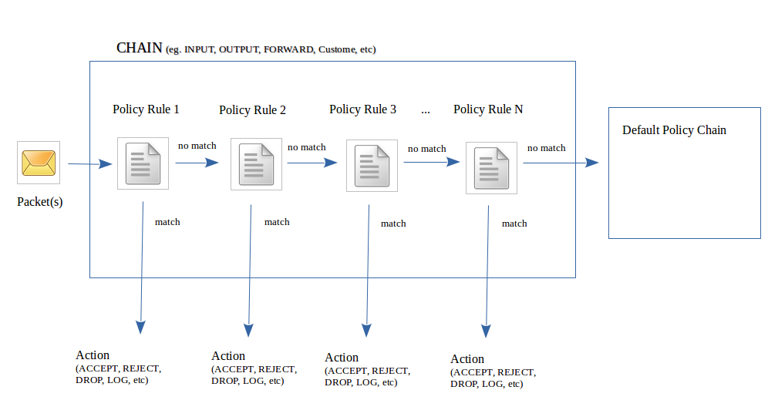
How iptables Works
Notes:
The real iptables can help much more than above chains.

Slide 25
Viewing iptables Rules
The iptables command is used to allow the Linux system administrator to set up policies in order to control access to the packets (tcp, udp, icmp, etc) that travel within a server.
Just as we’ve done with previous labs, it’s important to verify your current firewall configuration before making changes, as well as double-checking it after you’ve made them.
iptables –L - Lists all iptables rules (INPUT, OUTPUT, FORWARD, and any customized chains)
iptables -L –v - Verbosely lists all rules (includes total number of packets affected, etc)
iptables -L CHAIN-NAME - Lists all rules for that particular chain only. (INPUT, OUTPUT, etc)
iptables -L -v --line - Adds line numbers to the printed rules. Handy later.
Notes:
This is a must.

Slide 26
Flushing iptables
While you can save and restore iptables settings, it’s sometimes useful to “flush” (completely clear) the firewall rules for all or a particular chain.
iptables –F : Clears the rules for ALL chains
iptables -F CHAIN-NAME : Clears the rules for a single chain
Important: Each default chain includes a default policy that you can modify manually. This policy is NOT changed back by an iptables flush.
Notes:
Again, knowing how to back up iptables before yo flush it. ☺

Slide 27
Default Policies
Usually when setting policy rules with iptables, a general “overall” policy is set. This is the default policy.
A good way to think about setting policies is to have a “safety net” to take some sort of action to prevent un-handled packets from passing through the firewall by mistake.
Once a default policy is set, additional rules in the policy act as exceptions to this default.
An example would be an INPUT chain with a default policy of DROP, so no packets go into the server. We then put a rule for SSH, allowing connections that match SSH to go through, and then nothing else.
Notes:
Depends on your business, it could be
Blacklist style – deny – Access
Whitelist style – access - deny

Slide 28
Setting Default Policies
Let’s set the default policy:
iptables -P INPUT DROP
This drops all incoming packets, regardless of port, destination, source, or protocol. Setting a default policy to drop everything makes it easier to specify the very few exceptions we want to make.
By contrast:
iptables -P INPUT ACCEPT
This would allow everything through. If we wanted to harden our system, we would have to specify every single possible combination of input types. That’s awful, so let’s not do that.

Slide 29
Creating Rules
When creating rules to add to your iptables there are a few things you might be concerned with:
Which chain does it go in?
We will only use INPUT, FORWARD, and OUTPUT. There are more, but you won’t use them nearly as often as these, and you’ll learn about them in later courses.
What traffic are you trying to match?
What do you want to do with this traffic?
We will only use ACCEPT, DROP, and REJECT. There are more, but again, you’ll learn about them in later courses.

Slide 30
Matching Packets
There are a number of options you can use to match specific traffic:
-s <address> - source ip address. Who sent the traffic.
-d <address> - destination ip address. Who is receiving the traffic.
-p <protocol> - the protocol used by the packet. E.g. tcp, udp, icmp, all.
--dport/--sport <port number> - the port the traffic is being sent to/from. Only available if you use -p and a protocol that uses ports.
-i <interface name> - the incoming interface.
-o <interface name> - the outgoing interface.
Note that both interface options are only available in certain chains (e.g. you can’t specify an outgoing interface in INPUT).

Slide 31
Matching Packets Cont.
The options to match packets can be combined as needed.
e.g. icmp traffic sent from a known network to one of your interfaces.
If you don’t need one of those options, just leave it out.
e.g. if you don’t care who sent the traffic, don’t put a -s option in your rule.
The art of iptables is learning which options to combine to match the traffic you want.

Slide 32
Writing Your Rule
Once you know about the traffic you want, and what you want to do with it, you put it together to create a rule.
iptables –I <CHAIN> [traffic matching options] –j <target>
where:
the chain is the chain to add it to.
one or more of the options to match specific traffic.
the target is the action you want to take with this traffic.

Slide 33
Rule Order
The order of rules matters. This is why ‘iptables -L -v --line’ is so useful. It gives you the order it which packets go down the list. They start from 1, and go down.
If a packet matches two places in a chain, once it hits the first match, the packet is jumped somewhere else. It’ll never hit that second match. Keep that in mind.
‘iptables -I chain-name #num’ allows you to specify exactly where in the chain you want to add your new rule.
You can use -A instead of -I to place a rule at the end of a chain.
If you make a mistake, you can delete a specific rule:
iptables -D INPUT 3

Slide 34
Saving Your Rules
Any rules you write only last until you reboot.
Unless you manually save them.
The iptables-save command outputs information about your current rules.
Redirect the output to /etc/sysconfig/iptables
The iptables service automatically reads rules from that file when it starts, so just save your desired configuration there.
Just make sure you make a backup copy of the original file first, so you can always revert back to it if you encounter problems.

Slide 35
Summary
In this lesson you have learned the basics of configuring a common firewall on Linux machines: iptables.
There is much more to learn about firewalls (and you will do so in later courses), but even the basics covered here will allow you to better protect the machines under your control.
Notes:
Practice is the fule. Please check those tasks in lab 7 and kas yourself if you can create more rules based on business requirements.

Slide 36
Question
Focus on your test 1 first. ☺
???
Notes:
I cannot promise you to answer your email the same day. But, I will answer your question in the class now. ☺

Slide 37
Mini homeworks
No mark or bonus. But, good to do:
Find any Linux firewall info. See if there is any replacement of iptables.
Such practice is to predict what could be close to correct answers in future. ☺
Notes:
Practice is the key to learn and build muscle memory.

